Slide 1
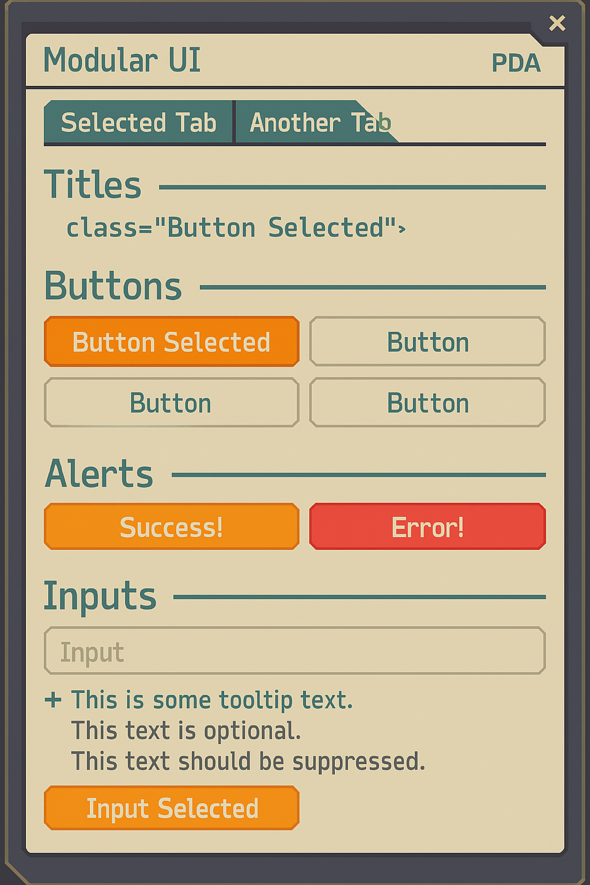
PDA Palette
screen
f8f2de
text
5ba9a9
highlight
f1693c
lines
30393e
alternate highlight
f99e2a
error/alert
d94f4f
disabled/inactive
b8b8b8
success/confirmation
4caf50
selected
e6d8b8
tooltip
ffffff (with 85% opacity)
shadow
1e1e1e (with 85% opacity)
glow/focus
f1693c (60% opacity)

Slide 2
Save as JPG, not PNG

Slide 3
RECEPTION
SECURITY OFFICE
MEDICAL OFFICE
STORAGE ROOM

Slide 4
TV ROOM
DINING ROOM
GYMNASIUM

Slide 5
SHOWER BLOCK
TOILET BLOCK
NO CAMERA FEED

Slide 6
CELL #1
CELL #5
CELL #2
CELL #3
CELL #6
CELL #4

Slide 7
RECEPTION CORRIDOR
OFFICE CORRIDOR
BACK CORRIDOR
RECREATION CORRIDOR

Slide 8
STAIRS (DOWN)
STAIRS (UP)
CELLS LANDING

Slide 9
Induction
Process
Record identification
Medical check
Remove personal property
Cell assignment

Slide 10
World Orbital Prison: MEDICAL SCANNER
File Home Scan Help
Prisoner ID:
H4095696
Scan Type:
Prisoner Induction
Annual Checkup
Prohibited Substances
Cancel
Prisoner Release
SCAN

Slide 11
















THIS WAY UP

Slide 12
To the cells

Slide 13
Prisoner
Property
Log
DO NOT REMOVE
Prisoner Property Log
A to G
Prisoner Property Log
H to M
Prisoner Property Log
N to S
Prisoner Property Log
T to Z

Slide 14
Action Hint Background

